Slide 1

Travel Experts
Impact IT
Winter 2019

Slide 2

Presentation Outline
Introductions
Products
Desktop
Website
Mobile
Demonstration
Q & A

Slide 3

INTRODUCTIONS
Impact IT
Louise Acosta
洪笠铭 （LiMing Hong）
Colin Lee-Chee
Hayley Mead

Slide 4
SOFTWARE COMPOSITION
THE PRODUCT CONSISTS OF THREE SOFTWARE BUNDLES
DESKTOP APPLICATION
WEBSITE
MOBILE SERVICE
User functionality
Office application
Website
Agent UX
Database
Customer UX
Features
Functionality
Notes:
Louise will show the dashboard; adding a new booking and invoice
LiMing will show the Website; show authentication and sign in
Hayley will show mobile app; bring up booking on the emulator

Slide 5

OFFICE APPLICATION
JAVA DESIGN WITH MYSQL DATABASE
The desktop application is designed to support Travel Agents staff with the following features:
Allow agents to manage the website for internal business requirements
Allow agent to control current bookings
Notes:
Allow agents to manage the website for internal business requirements
DO: Store and update information in demonstration
-Show dashboard and add booking
-Create and invoice
Allow agent to control current bookings

Slide 6

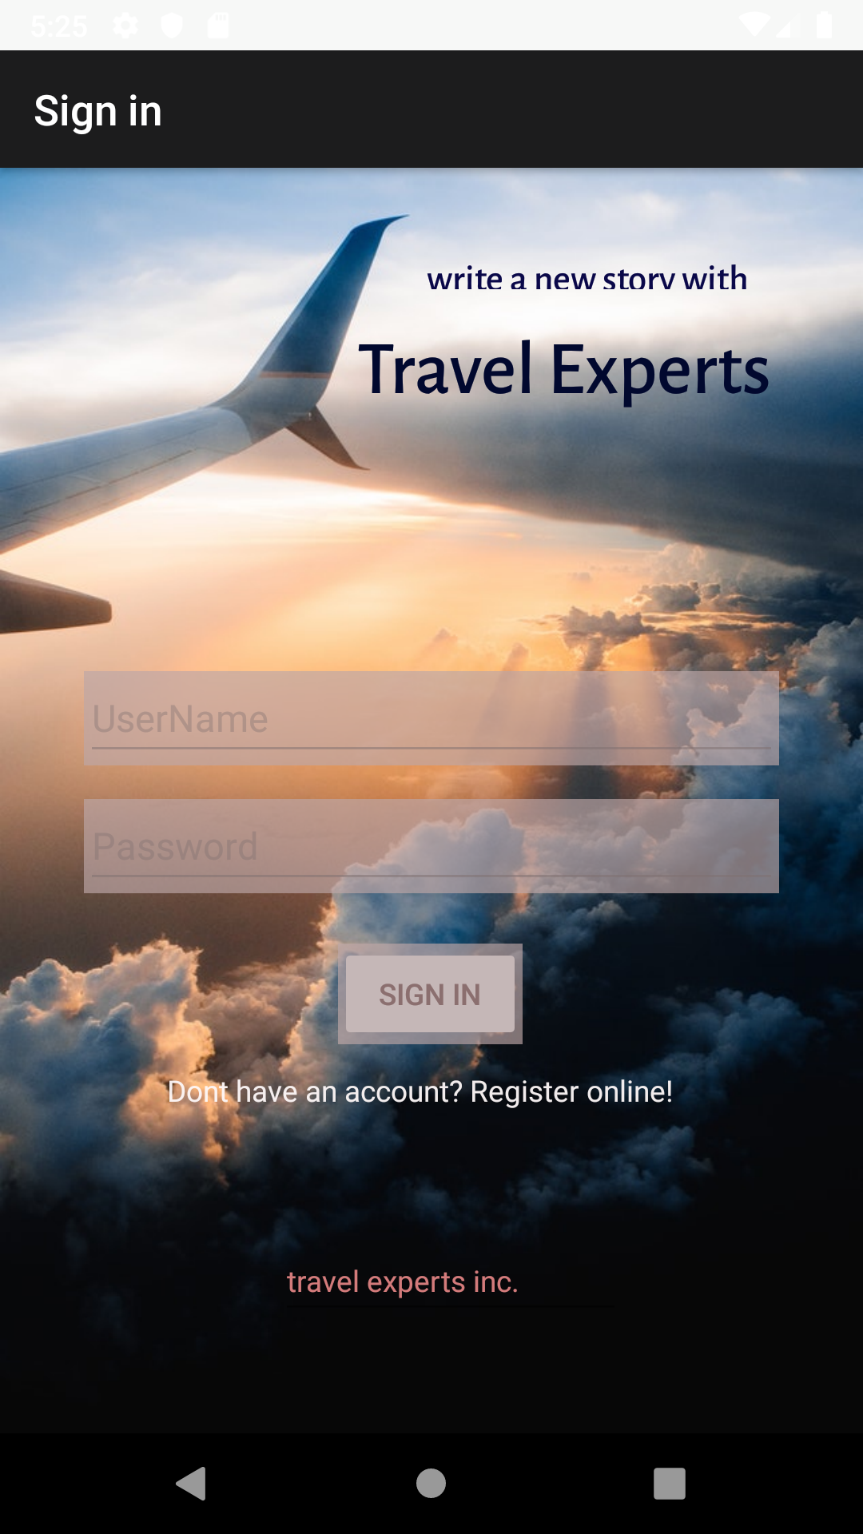
WEBSITE AND MOBILE APPLICATION
WHERE DO YOU WANT TO GO?

Slide 7

Thank you for listening

Slide 8

HAVE A NICE DAY!
Impact IT
Phone:
403-667-5788
Email:
INQUIRIES@IMPACT_IT.COM

